Slide 1
Chapter 11
ONE-WAY BETWEEN-GROUPS ANOVA

Slide 2
Introduction
What if you want to compare more than 2 groups?
For example, is stress related to year in school?
  (FR; SO; JR; SR)
Why not just run a bunch of t tests?
  FR vs. SO
  FR vs. JR
  FR vs. SR
  SO vs. JR
  SO vs. SR
  JR vs. SR

Slide 3
Introduction
Remember, Type I error occurs when we reject a null hypothesis that is actually true.
If α = .05, the probability of correctly retaining a true null hypothesis is .95

Slide 4
Introduction
Assuming the null hypothesis is true, what’s the probability of not committing a Type I error (that is, retaining the null) on 2 t tests?
P(A and B) = P(A) x P(B) = .95 x .95 = .9025
If I ran all 6 t tests, the probability of not committing a Type I error is reduced to .7351

Slide 5
Between-groups one-way ANOVA
A hypothesis test used when you have
  one nominal IV with at least 3 levels
  a scale DV
  between-subject design (different people in each group)

Slide 6
Between-groups one-way ANOVA
Remember the t tests:
difference between means
standard error
between-groups variability
within-groups variability
t =
t =

Slide 7
Between-groups one-way ANOVA
Remember the t tests:
difference between means
standard error
between-groups variance
within-groups variance
t =
F =

Slide 8
Between-groups one-way ANOVA
between-groups variance
within-groups variance
“variance of the means”
F =
“mean of the variances”

Slide 9
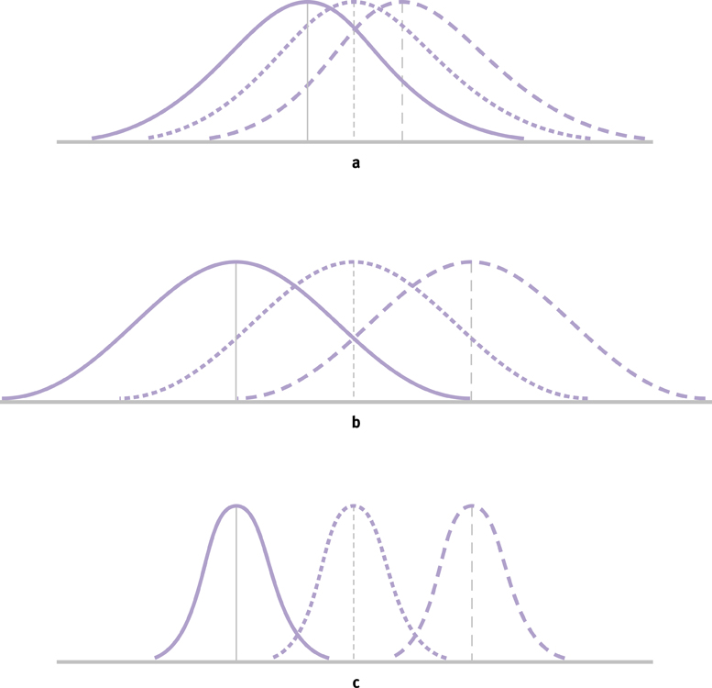
The F Statistic

Slide 10
The F Distributions
multiple F distributions
identified by two df measures
  one df is associated with the numerater (number of samples)
  the other df is associated with the denominator (sample sizes)

Slide 11
Assumptions
random selection of samples
normal distribution of DV in populations
homogeneity of variances
  samples come from populations with similar variances

Slide 12
Example
The following data were obtained from an between-groups experiment designed to measure the effectiveness of three pain relievers (A, B, and C)
DV = amt of time (sec) that subjects can withstand a painful stimulus
Drug A | Drug B | Drug C
9 | 9 | 4
8 | 7 | 3
7 | 6 | 1
5 | 5 | 1

Slide 13
Step 1: Identify
Populations
  Population 1 = individuals given Drug A
  Population 2 = individuals given Drug B
  Population 3 = individuals given Drug C
Comparison distribution
  F distribution
Hypothesis test
  one-way between-groups ANOVA
Assumptions
  subjects not randomly selected
  do not know if populations are normally distributed
  we’ll check variances for homoscedasticity

Slide 14
Step 2: H₀ & H₁
H₀ : No differences between population means
  H₀ : μ₁ = μ₂ = μ₃
H₁ : At least one population mean is different from at least one other population mean
  This is not the same as H₁ : μ₁ ≠ μ₂ ≠ μ₃
  Don’t use symbols to express H₁

Slide 15
Step 3: Identify the Sampling Distribution
df_{bwn} = N_{groups} – 1 = 3 – 1 = 2
df_{within} = df₁ + df₂ + df₃
  df₁ = 4 – 1 = 3
  df₂ = 4 – 1 = 3
  df₃ = 4 – 1 = 3
df_{within} = 3 + 3 + 3 = 9

Slide 16
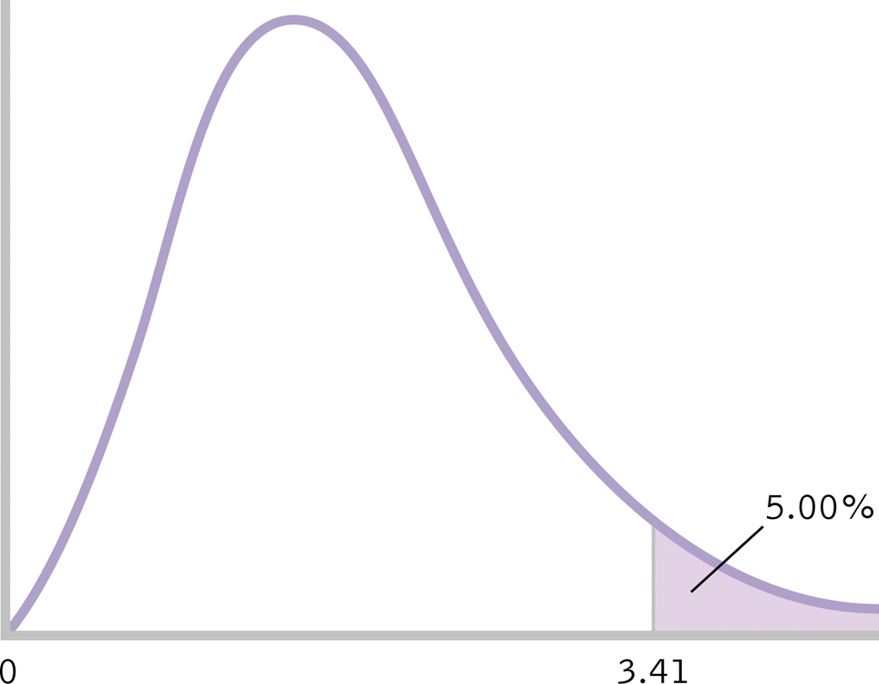
Step 4: Determine Critical Value
critical F = 4.26
4.26

Slide 17
Step 5: Calculate F
Calculate total sum of squares (SS_{total})
SS_{total} = ∑(X – GM)² = 84.96

Slide 18
Step 5: Calculate F
Calculate within-groups sum of squares (SS_{within})
SS_{within} = ∑(X – M)² = 24.22

Slide 19
Step 5: Calculate F
Calculate between-groups sum of squares (SS_{between})
SS_{between} = ∑(M – GM)² = 60.68

Slide 20
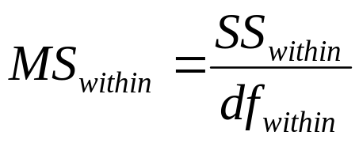
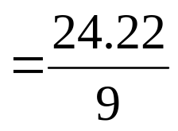

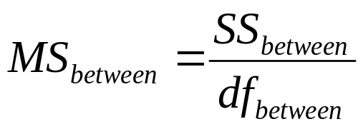
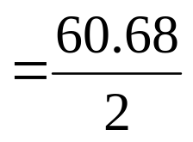

Step 5: Calculate F
Calculate MS_{within}
Calculate MS_{between}

Slide 21
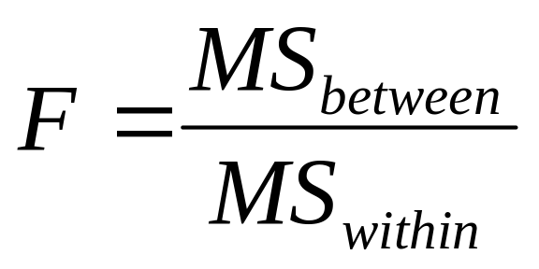
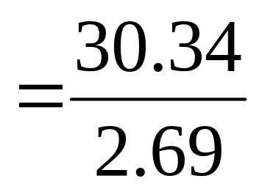
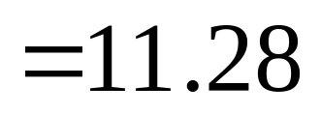
Step 5: Calculate F

Slide 22


Step 6: Make a Decision
Check to make sure we met assumption of equal variances
Is calculated F in critical region of sampling distribution?
11.28

Slide 23
Step 6: Make a Decision
Reject H₀
The three samples do not come from identical populations.
At least one of the drugs resulted in significantly different tolerance to pain, F(2,9)=11.28, p < .05

